Slide 1

Data science course
Final Project
Students Performance Analysis
Prediction of Student's performance based on social and demographic features.
Presented by:
Adel Altuwaijri

Slide 2



Problem & Dataset
Exploratory Data Analysis
Machine Learning Models
Conclusions

Slide 3
Student performance data approach student achievement in secondary education of two Portuguese schools. The data attributes include student grades, demographic, social and school related features) and it was collected by using school reports and questionnaires

Slide 4
Risks\Limitations
There are many students who score zero marks in the final exam. we have no idea whether they are real scores or a sign that these students do not attend the final exam for some reason.
There are a large number of students who score zero marks in the final exam. because we do not know whether they are real scores or a sign that these students do not attend the final exam for some reason.

Slide 5
Problem Statment
Can we expect the final grades for students ?
Can we classify the students at risk in passing a course from the given data ?
What are the relevant features required to classify the final grade outcome ?

Slide 6


DATASET
Structured raw dataset available at UCI ML Repository .
(rows=1044, columns=33)
Portuguese school collated student reports and questionnaires
Convert dependent variable final grade G3 to categorical

Slide 7
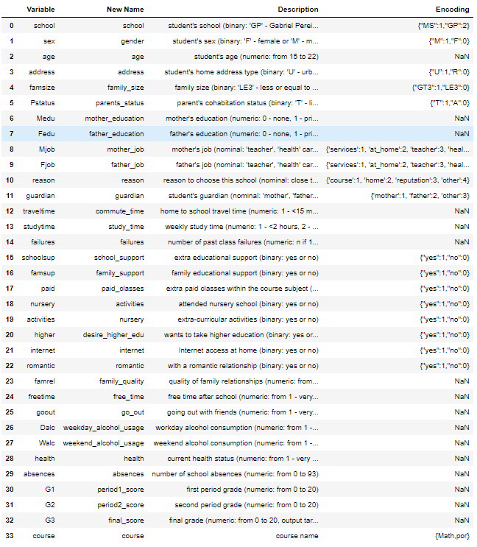
Shape
Rows : 1044
Columns: 33
Data Types
Object : 13
Numeric: 20
No Nulls
No Duplications

Slide 8
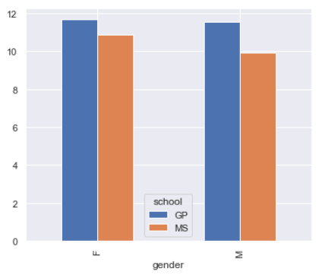
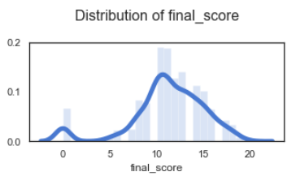
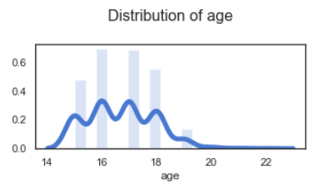
Distribution of Final Scores

Slide 9
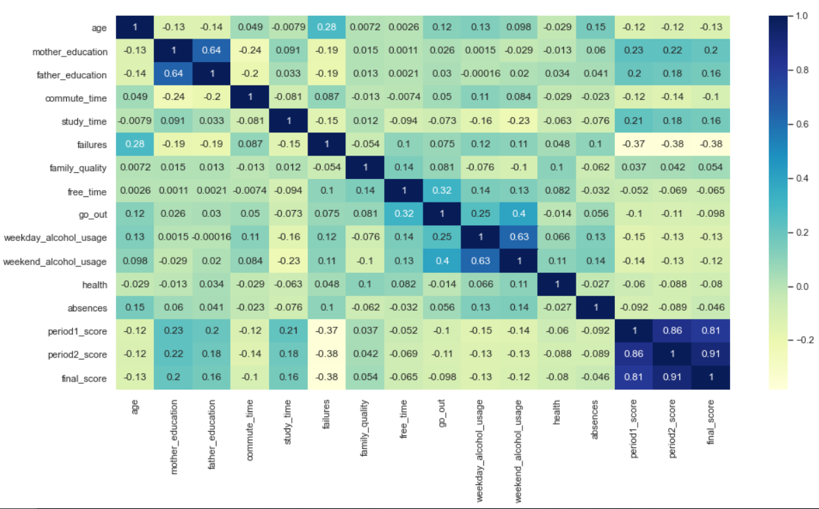
Correlation Matrix

Slide 10
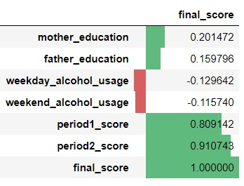
Collinearity

Slide 11
Data Manipulation
Data Pre-processing
Features Selection

Slide 12
Data Pre-Processing
Ordered categories
No chages
Encoded with sensible numeric values
Unordered categories
Dummy encoding (0/1)

Slide 13
Feature Selection
SelectKBest
f_regression ( Regression )
chi2 ( Classification )
Most important predictors
f_regression
chi2
- course_por
- desire_higher_edu_yes
- failures
- mother_education
- period2_score
- school_MS
- study_time
- weekday_alcohol_usage
- absences
- course_por
- failures
- father_job_teacher
- mother_education
- period2_score
- school_MS
- study_time

Slide 14
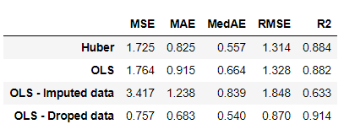
Linear Regression
Training and Testing ratio of 75:25
Target variable (categorical)
- Whether a student is likely to pass the final exam .
Resulting Metrics
Robust Regressor ( Huber )

Slide 15
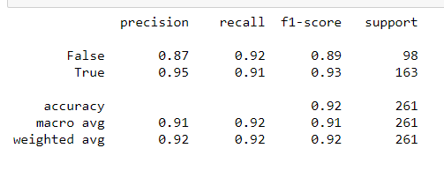
Logistic Regression
Target variable (categorical)
- Whether a student is likely to pass the final exam .
Classification Report
for all students who classified "PASS", 95 percent was correct
for all students who were actually "PASS", 91 percent was classified correctly

Slide 16
Conclusions

Slide 17
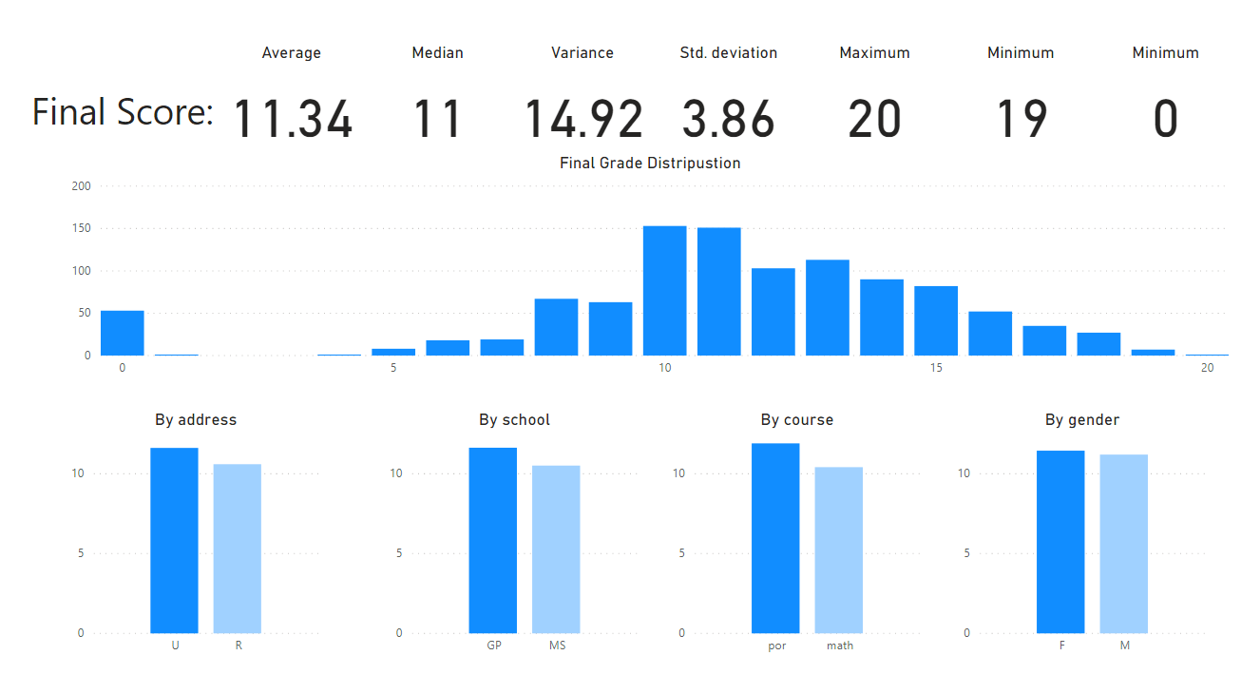

Slide 18
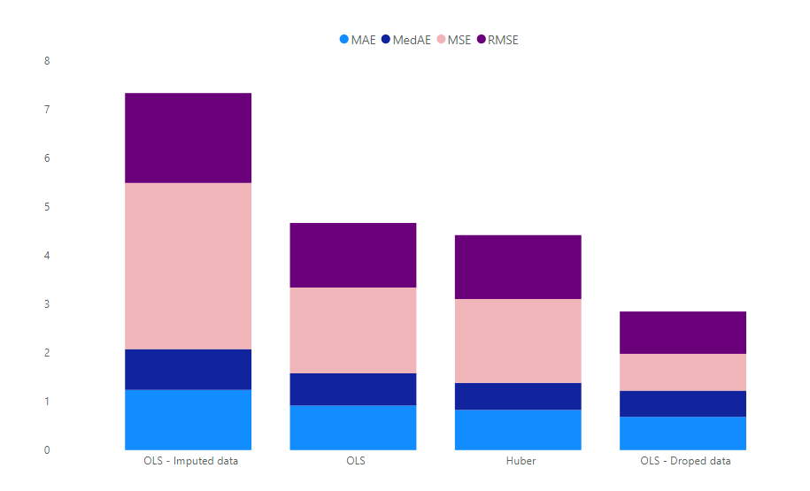
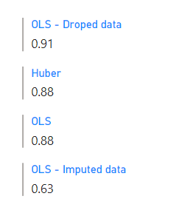
Regression Losses
R-Squared Metric

Slide 19
Provide the stakeholders with an integrated solution such as a learning management system to ensure coherent collection of data
The LMS will act as an early warning system for school management to take additive measures so that the at-risk students are able to cope up
Although student achievement is highly influenced by previous evaluations, certain features affect the direct outcome – the school can take action to lower failure rate
This will improve the quality of education imparted as well as help in resource management

Slide 20
Collecting data from numerous cohorts from multiple schools for a particular district, state and country
Broaden the dataset through questions that account for student psychological and social behavior
Applying Deep Learning models

